Slide 1
Lesson 4 Spies in the Land

Slide 2
Worship

Slide 3
Worship
Focus on God.
Listen to your teachers (cos they are helping you to focus).
Be sincere.
Colossians 3:23 Whatever you do, work at it
wholeheartedly as though you were doing it for the Lord and not merely for people.

Slide 4
Recap

Slide 5
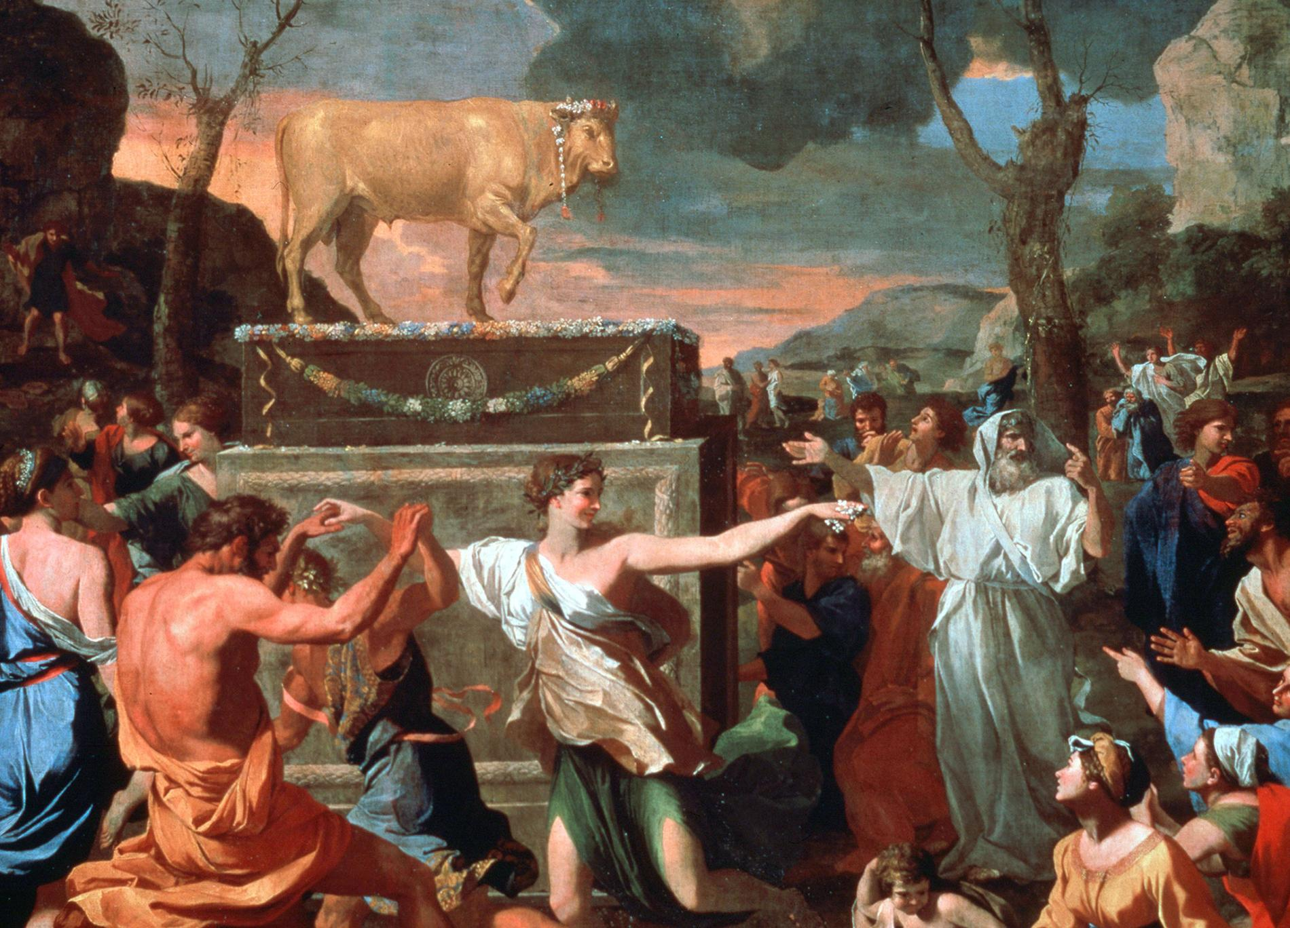
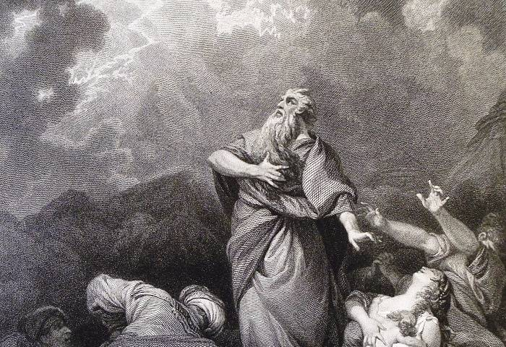
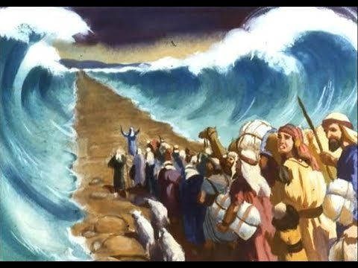
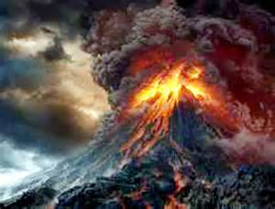
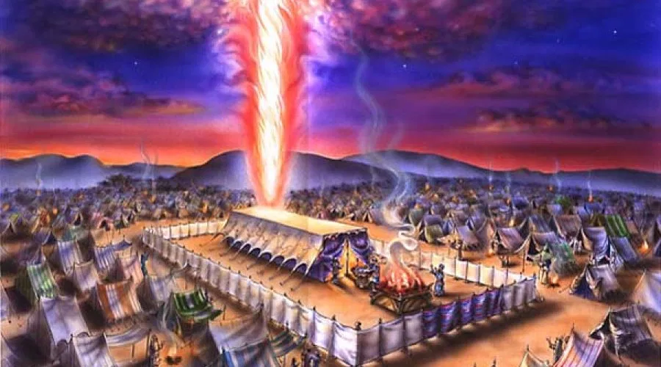
God loves Israel and displays his love in real action
Israel rebelled against God despite God telling them not to make images of God
God’s anger and refusal to go with them
(they were destroying themselves by rebelling against God’s kindness)
God chooses Moses to plead for Israel
God’s forgives them and relationship to Israel is restored
God loves you and wants you to love him too
We rebel against God and go our own way as enemies of God (sin)
God needs to punish our sin by condemning us to death
God chooses Jesus to plead for us
God’s relationship to us is restored (if you turn away from sin and follow Jesus)

Slide 6
Quiz
Golden calf
1 and 2. You shall have no other gods before me. You shall not make any image and worship it.
Wipe out Israel and restart again with Moses.
Moses pleaded with God and offered himself in exchange for Israel
God might destroy Israel because they were so sinful.
Empty, nothing special, not worth it.
Moses pleaded with God based on Moses’ favour with God
Jesus pleads for us like Moses pleaded for Israel’s life; God chose Jesus and Moses to plead.
Jesus is God, Jesus sacrificed his life for our lives but Moses didn’t die for Israel.
What evil thing did Israel do that God was so angry with?
What commandment did Israel break?
What two things did God want to do to Israel as a result of their sin?
What two things did Moses do to change God’s mind?
Even after he said he wouldn’t destroy Israel, why didn’t God want to go with Israel to the Promised Land?
Even though the Promised Land had a lot of resources, what would the Promised Land be like without God?
What made God agree to go with Israel?
How is Jesus similar to Moses?
How is Jesus different to Moses?

Slide 7
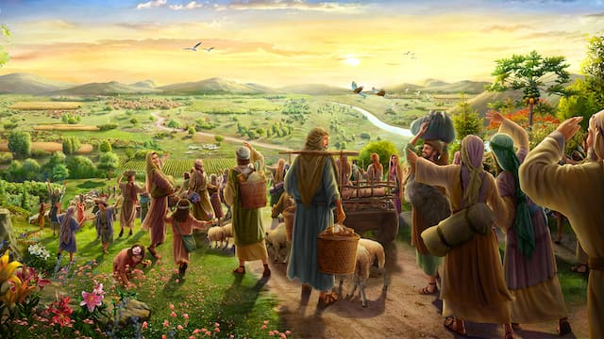
The Israelites FINALLY reached the border to the Promised Land!
But once again they did a very evil thing…

Slide 8
Lesson

Slide 9
Video
https://www.youtube.com/watch?v=MmWhLAAqFEo&feature=youtu.be&ab_channel=LifeKids

Slide 10
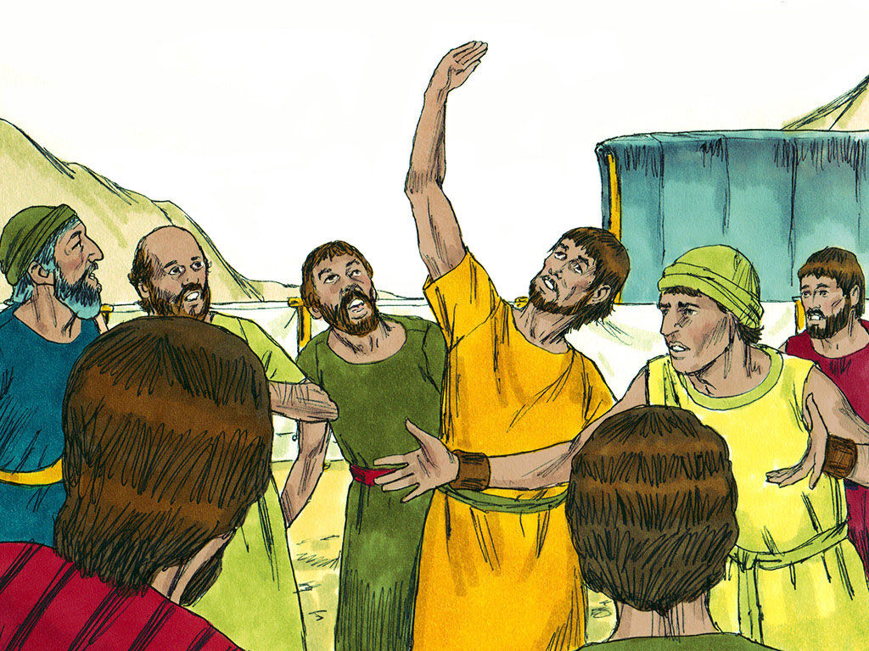

Slide 11
Activity

Slide 12
Ten of the spies saw the giants and were afraid
Caleb and Joshua remembered God’s promises and were brave
Numbers 13

Slide 13
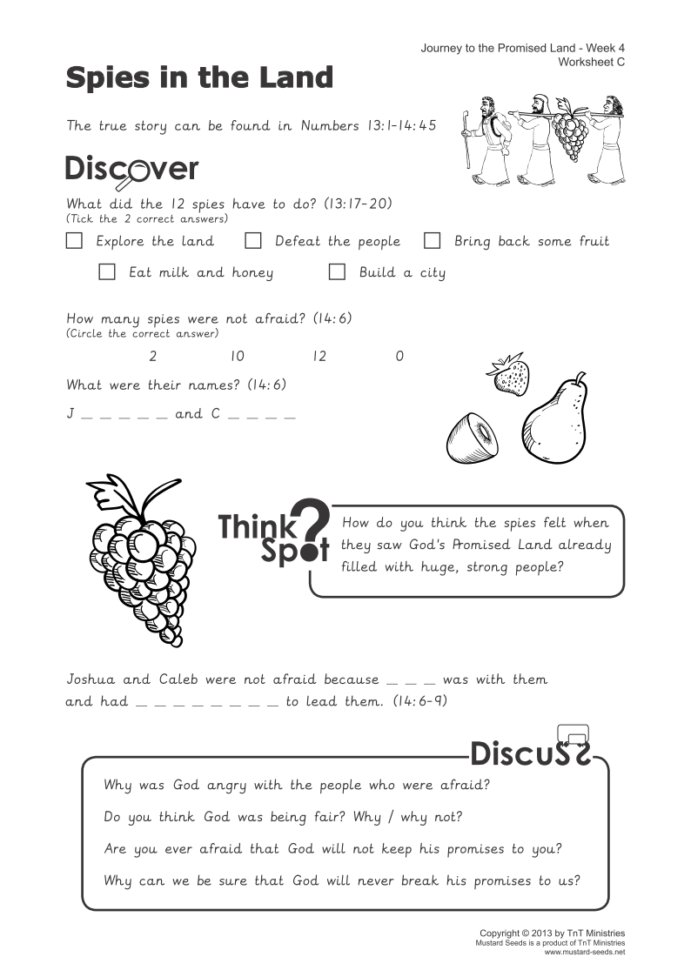

Slide 15
The Big Idea
Spies explored the good land God had promised to give Israel, but the people did not trust God to help them fight the Canaanites so he punished them.
We can bravely do what God has told us to do when we trust him to keep his promises

